Slide 1
Vitamin D and COVID-19: Update, November 25, 2020
William B. Grant, PhD
Sunlight, Nutrition and Health Research Center
San Francisco, CA, USA

Slide 2
Disclosure
I receive funding from Bio-Tech Pharmacal, Inc. (Fayetteville, AR), a supplier of research-grade vitamin D at low cost.
I also work closely with two vitamin D-advocacy organizations:
  GrassrootsHealth.net
  VitaminDWiki.com

Slide 3
Outline
Observational studies of COVID-19 and 25(OH)D
2 “Quasi-experimental” studies of vitamin D supplementation of COVID-19 patients
2 RCTs of vitamin D treatment of COVID-19
Mechanisms of vitamin D in reducing COVID-19 risk
SARS-CoV-2 seropositivity with respect to 25(OH)D
Racial disparities of seropositivity related to 25(OH)D
Age effects on COVID-19 deaths
Seasonality of viral infections that peak in winter
Recommendations for vitamin D re COVID-19
For more information

Slide 4
Observational Studies of COVID-19 with Respect to serum 25(OH)D
To date there have been at least 15 reports of COVID-19 with respect to serum 25(OH)D concentration.
Most have reported inverse correlations of COVID-19 risk, severity and/or death with respect to serum 25(OH)D concentration.
In general:
  Death: 25(OH)D <10 ng/mL (25 nmol/L)
  Severe disease: 25(OH)D <20 ng/mL
  Moderate disease: 20 ng/ml <25(OH)D <30 ng/mL
  Mild disease: 25(OH)D >30 ng/mL

Slide 5
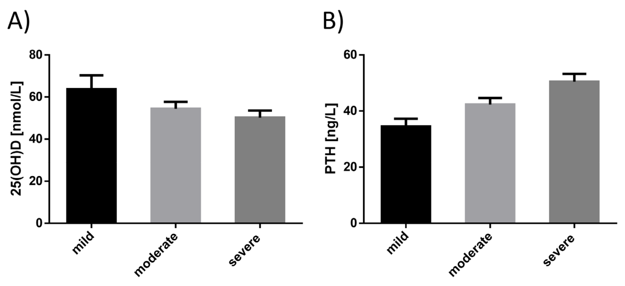
25(OH)D vs. Severity in Austria for 109 COVID-19 Patients aged 58 ± 14 years
Pizzini et al., Nutrients 2020, 12(9), 2775

Slide 6
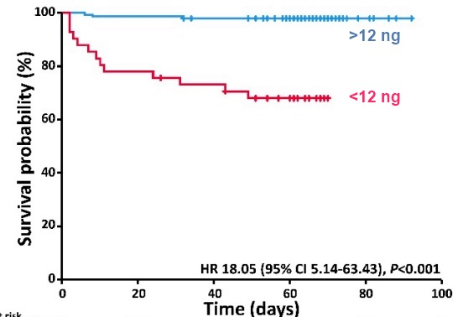
Much More Likely to Die of COVID-19 if 25(OH)D <12 ng/ml (30 nmol/L)
Based on 185 Patients aged 50-70 years in Germany
HR 15 (95% CI 4–52,
p < 0.001)
Nutrients 2020, 12(9), 2757;
https://doi.org/
10.3390/nu12092757

Slide 7
Quasi-Experimental Study
Population: 66 residents of a nursing home in France with recently diagnosed COVID-19; mean age 88±9 yrs.
Intervention: 57 had received 80,000 IU vitamin D the previous month or within one week after diagnosis of COVID-19.
Outcome: During follow up of 36±17 days, 83% of supplemented residents survived; only 44% of comparator group (N = 9) survived; aHR = 0.11 (95% CI, 0.03 to 0.48, p=0.003).
Annweiler et al. JSBMB
https://doi.org/10.1016/j.jsbmb.2020.105771

Slide 8
Vitamin D Supplementation Associated to Better Survival in Hospitalized Frail Elderly COVID-19 Patients: The GERIA-COVID Quasi-Experimental Study
An observational study in France.
77 patients consecutively hospitalized for COVID-19 in a geriatric unit were included. Intervention groups were participants regularly supplemented with vitamin D over the preceding year [50,000 IU/month vitamin D3 or 80k-100k every 2-3 months (Group 1)], and those supplemented with 50,000 IU vitamin D₃ after COVID-19 diagnosis (Group 2). There was also a comparator group not supplemented with vitamin D.

Slide 9
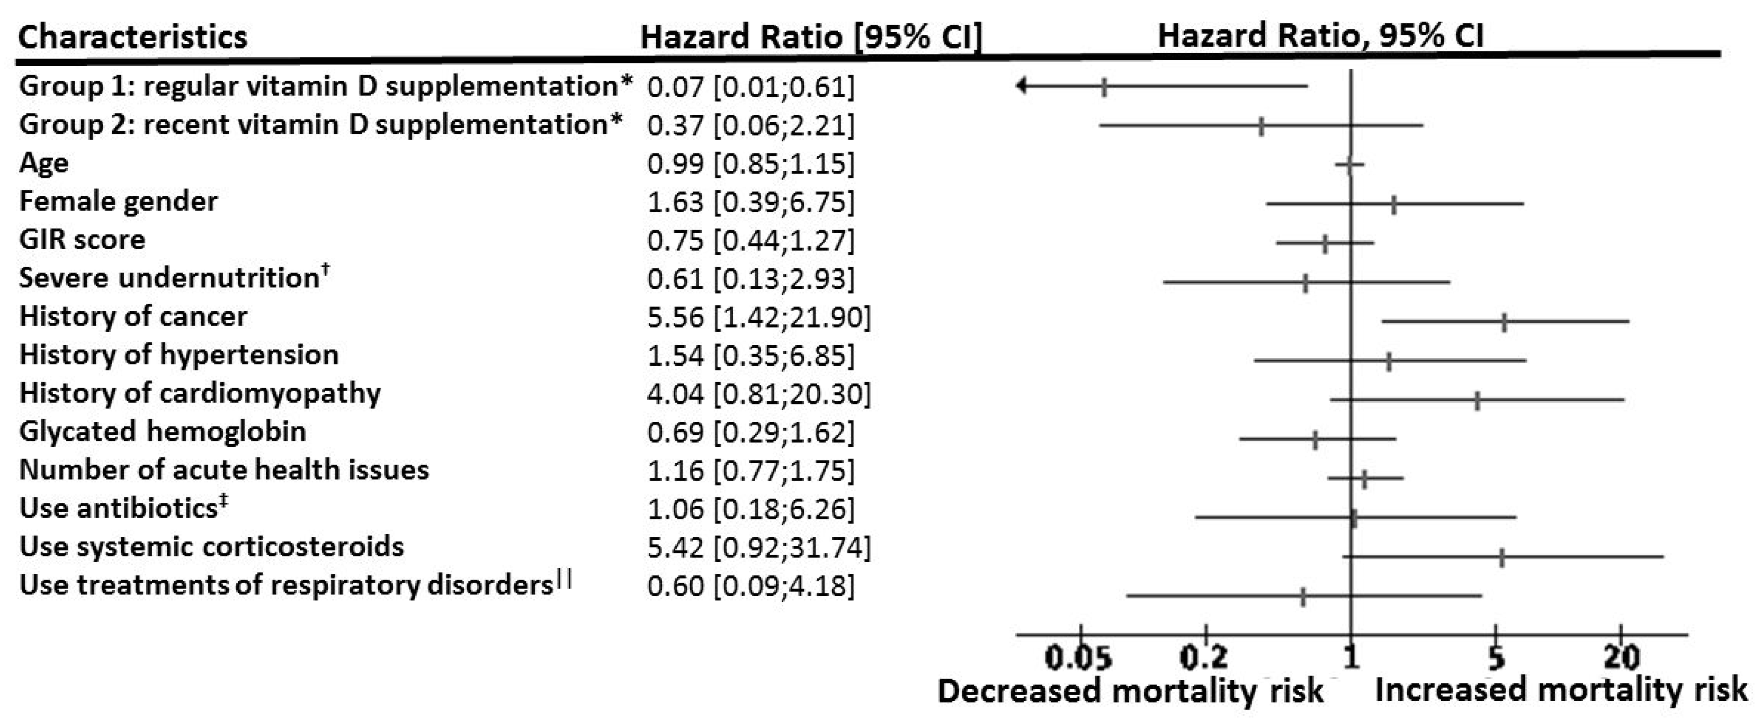
Vitamin D Supplementation Associated to Better Survival in Hospitalized Frail Elderly COVID-19 Patients:
14-day outcomes
Compared to the non-supplemented group, adjusted for age, gender and GIR score (a measure of functional ability)

Slide 10
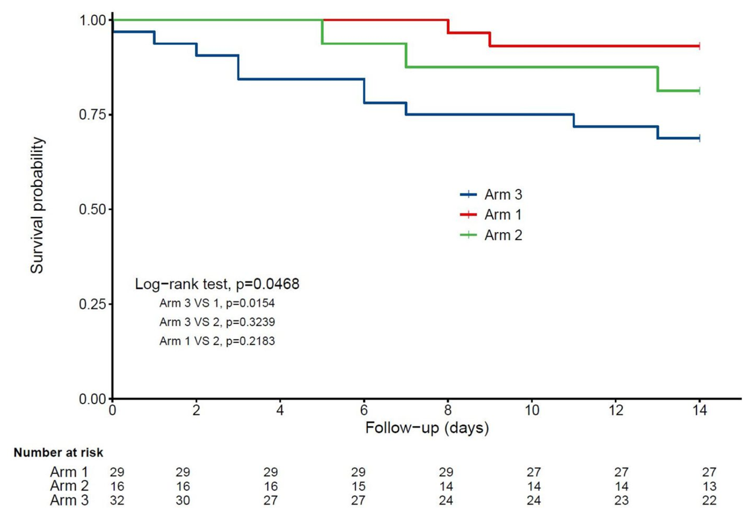
Vitamin D Supplementation Associated to Better Survival in Hospitalized Frail Elderly COVID-19 Patients:
Kaplan-Meier estimates

Slide 11
"Effect of Calcifediol Treatment and best Available Therapy versus best Available Therapy on ICU Admission and Mortality Among Patients Hospitalized for COVID-19: A Pilot Randomized Clinical study"
All hospitalized patients (76) received as best available therapy the same standard care of a combination of hydroxychloroquine and azithromycin. Eligible patients (50) were allocated to take oral calcifediol (0.532 mg), or not. Patients in the calcifediol treatment group continued with oral calcifediol (0.266 mg) on day 3 and 7, and then weekly until discharge or ICU admission.
(Calcifediol is 25(OH)D₂ and week one treatment: 130,000 IU vitamin D₂. Calcifediol acts faster that vitamin D by a day or two due to bypassing conversion in the liver.)
Entrenas Castillo et al. J Steroid Biochem Mol Biol. 2020 Oct;203:105751 doi: 10.1016/j.jsbmb.2020.105751. Epub 2020 Aug 29.

Slide 12
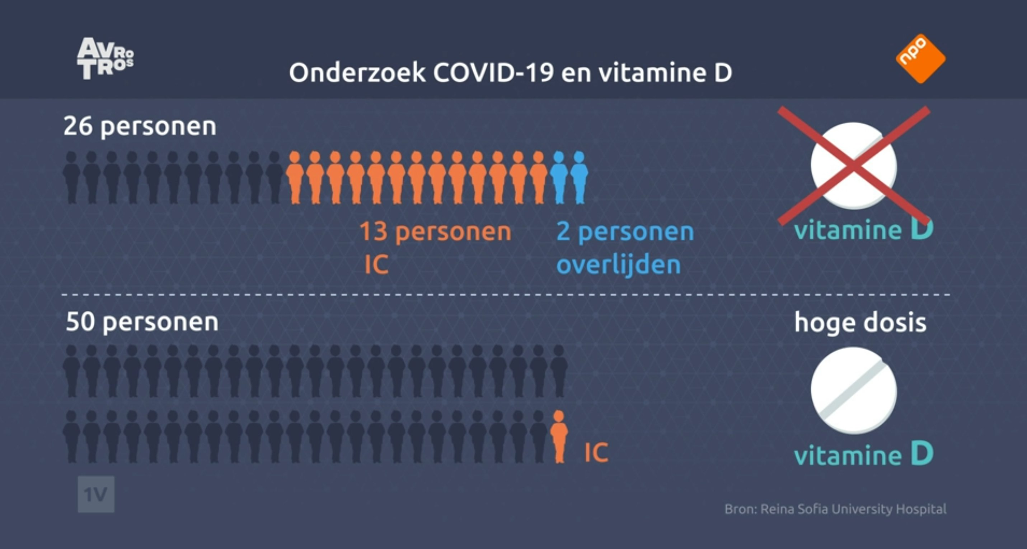
Results of the Pilot Randomized Clinical study – Entrenas Castillo et al., 2020

Slide 13
Short term, high-dose vitamin D supplementation for COVID-19 disease: a randomised, placebo-controlled, study (SHADE study)
An RCT conducted in India involving 40 asymptomatic or mildly symptomatic SARS-CoV-2 RNA positive vitamin D deficient (25(OH)D<20 ng/ml) individuals admitted to a tertiary hospital in north India without major comorbidities or requiring invasive ventilation or having 25(OH)D >20 ng/ml.
16 intervention participants, 6 males, age 50 (36-51) years, 25(OH)D = 9 (7 – 13) ng/ml
24 controls, 14 males, age 48 (39 – 49) years, 25(OH)D = 10 (8 – 13) ng/ml
Rastogi A, et al, Malhotra P.Postgrad Med J. 2020 Nov 12:postgradmedj-2020-139065. doi: 10.1136/postgradmedj-2020-139065.

Slide 14
Short term, high-dose vitamin D supplementation for COVID-19 disease: Results
10 out of 16 patients achieved 25(OH)D>50 ng/ml by day-7 and another two by day-14 [day-14 25(OH)D levels 52 (49 to 60) ng/ml in intervention group and 15 (13 to 20) ng/ml (p<0.001) in the control group].
10 (63%) participants in the intervention group and 5 (21%) participants in the control arm (p<0.02) became SARS-CoV-2 RNA negative.
Fibrinogen levels significantly decreased with vitamin D₃ supplementation (intergroup difference 0.70 ng/ml; P=0.007) unlike other inflammatory biomarkers.

Slide 15
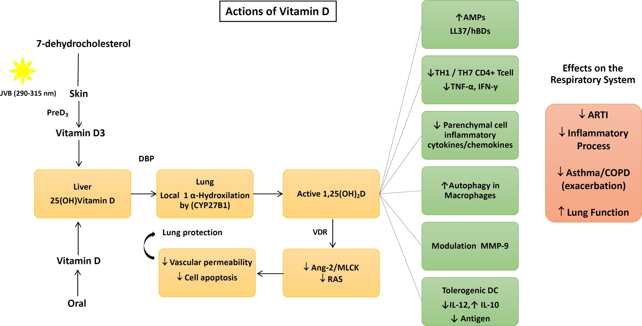
Mechanisms
Dos Santos et al. Arch Endocrinol Metab.
2020;S2359-39972020005006214.

Slide 16
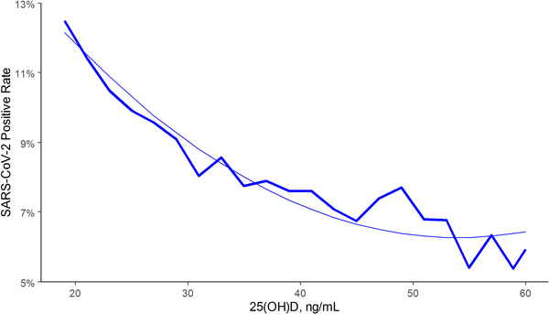
SARS-CoV-2 NAAT positivity rates and circulating 25(OH)D levels in the total population
COVID-19 can follow if the immune system does not act properly.
Kaufman,… Holick, PLoS One. 2020 Sep 17;15(9):e0239252.

Slide 17
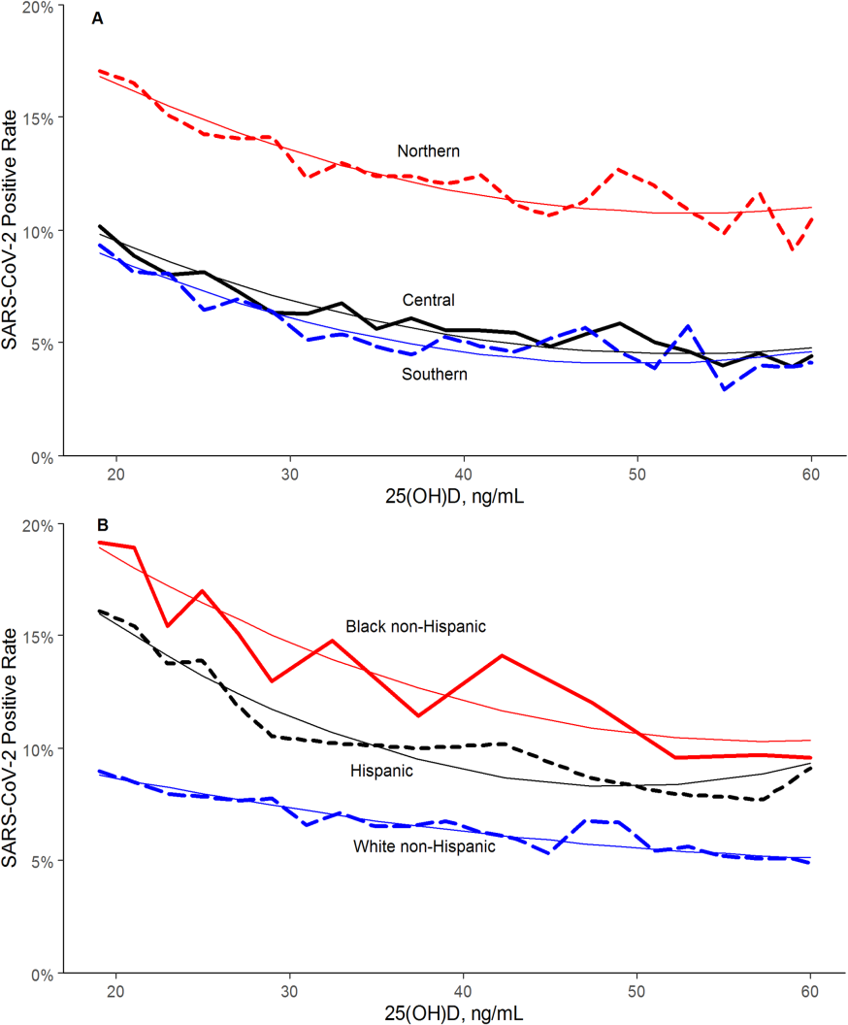
Effects of Race and 25(OH)D on SARS-CoV-2 seropositivity
The findings regarding race/ethnicity
and seropositivity indicate that blacks and Hispanics have higher rates than whites primarily due to non-vitamin D effects. However, if blacks and Hispanics were to increase 25(OH)D concentrations by vitamin D supplementation, they could reduce seropositivity by about 30%

Slide 18
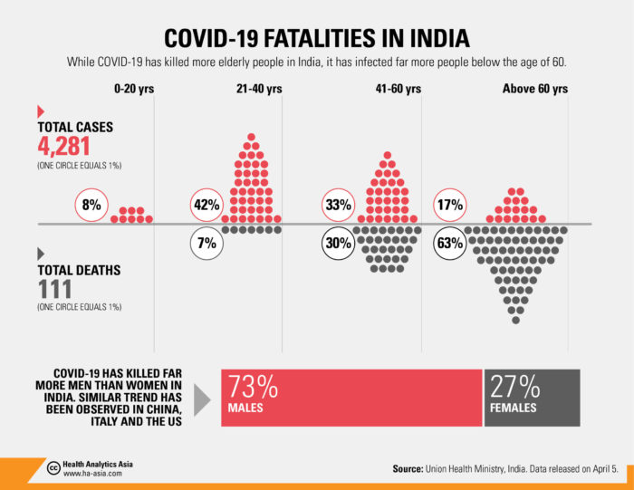
Effect of Age on Incidence, Death

Slide 19
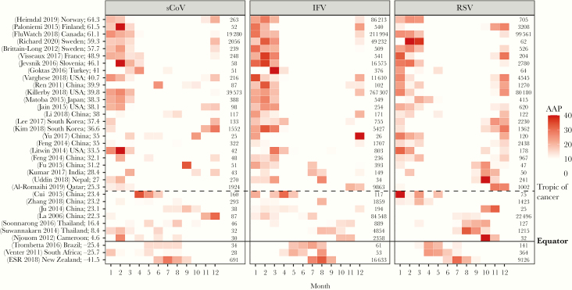
Seasonality of Viral Infections
You Li et al. J Infect Dis. 2020 Sep 1;222(7):1090-1097. doi: 10.1093/infdis/jiaa436

Slide 20
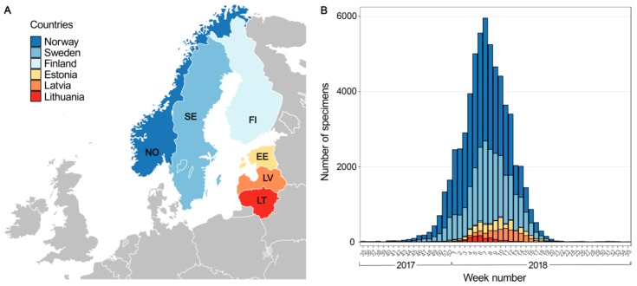
Low Temperature and Low UV Indexes Correlated with Peaks of Influenza Virus Activity in Northern Europe during 2010⁻2018
Ianevski et al. Viruses. 2019 Mar 1;11(3):207. doi: 10.3390/v11030207.

Slide 21
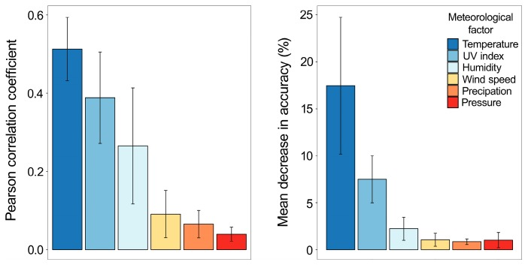
Low Temperature and Low UV Indexes Correlated with Peaks of Influenza Virus Activity in Northern Europe during 2010⁻2018
Implications:
Influenza rates are
reduced in winter at high latitudes due to lower temperature, UV dose, and humidity due to reduced viability of the virus outside the human body.

Slide 22
One-third of Mayo Clinic Staff are SARS-CoV-2 Seropositive, Nov. 17
ROCHESTER, Minn. — Over 900 Mayo Clinic staff have contracted COVID-19 in the past two weeks, according to a Tuesday briefing by Dr. Amy Williams, dean of clinical practice.
Williams said that 93 percent of staff who have contracted the virus did so in the community, and that the majority of those who contracted the virus at work did so while eating in a break room with a mask off.
“It shows you how easy it is to get COVID-19 in the Midwest,” said Williams, during an afternoon press call. “Our staff are being infected mostly due to community spread, and this impacts our ability to care for patients. We need everyone in the communities we serve to do their part to limit the spread of COVID-19.”

Slide 23
Recommendations
For health care workers dealing with COVID-19 patients;
For those at greatest risk of COVID-19 (elderly, obese, chronic diseases, lung diseases, high social contact);
For those with recently diagnosed COVID-19 or SARS-CoV-2 seropositivity:
Consider taking 100,000-200,000 IU vitamin D₃ within a week to rapidly raise 25(OH)D concentration, followed by 4000 or 5000 IU/d or up to 50,000 IU/week.
No adverse effects of high-dose vitamin D supplementation have been found for COVID-19 patients.

Slide 24
Details Regarding 14 Observational Studies, 3 Treatment Studies, and Mechanisms are Discussed in This Open Access Review
Mercola J, Grant WB, Wagner CL.
Evidence Regarding Vitamin D and Risk of COVID-19 and Its Severity.
Nutrients. 2020 Oct 31;12(11):E3361.
doi: 10.3390/nu12113361.

Slide 25
For Further Information
Does Vitamin D Protect Us from COVID-19? What Is the Required Dosage? Can Too Much Vitamin D Harm Us?By Michael F. Holick, October 30, 2020, VuMedi.com
Search for journal publications
  https://pubmed.ncbi.nlm.nih.gov/
  https://scholar.google.com/
Vitamin D advocacy organization
  Grassrootshealth.net
  VitaminDWiki.com (has a large collection of vitamin D information)

